Slide 1

STUDENT MANAGEMENT SYSTEM
DATABASE MANAGEMENT SYSTEM
MVJ19CS52
MINI PROJECT
2021-2022
Prepared by:
Name: Vikash singh
USN: 1MJ19CS185
Approved by AICTE |Affiliated to VTU | Recognized by UGC with 2(f) & 12(B) status |Accredited by NBA and NAAC

Slide 2
ABSTRACT
Student Management System is software which is helpful for students as well as the school authorities. In the current system all the activities are done manually. Its time saving and scalable. Our Student Management System deals with the various activities related to the students In the software we can register as a user and user has two types student and administrator. Administrator has the power to add new user and can edit the student details entered. A admin can add students record ,attendance status with department wise. All students can search his/her basics details and attendance status with there respective roll numbers
Approved by AICTE |Affiliated to VTU | Recognized by UGC with 2(f) & 12(B) status |Accredited by NBA and NAAC

Slide 3
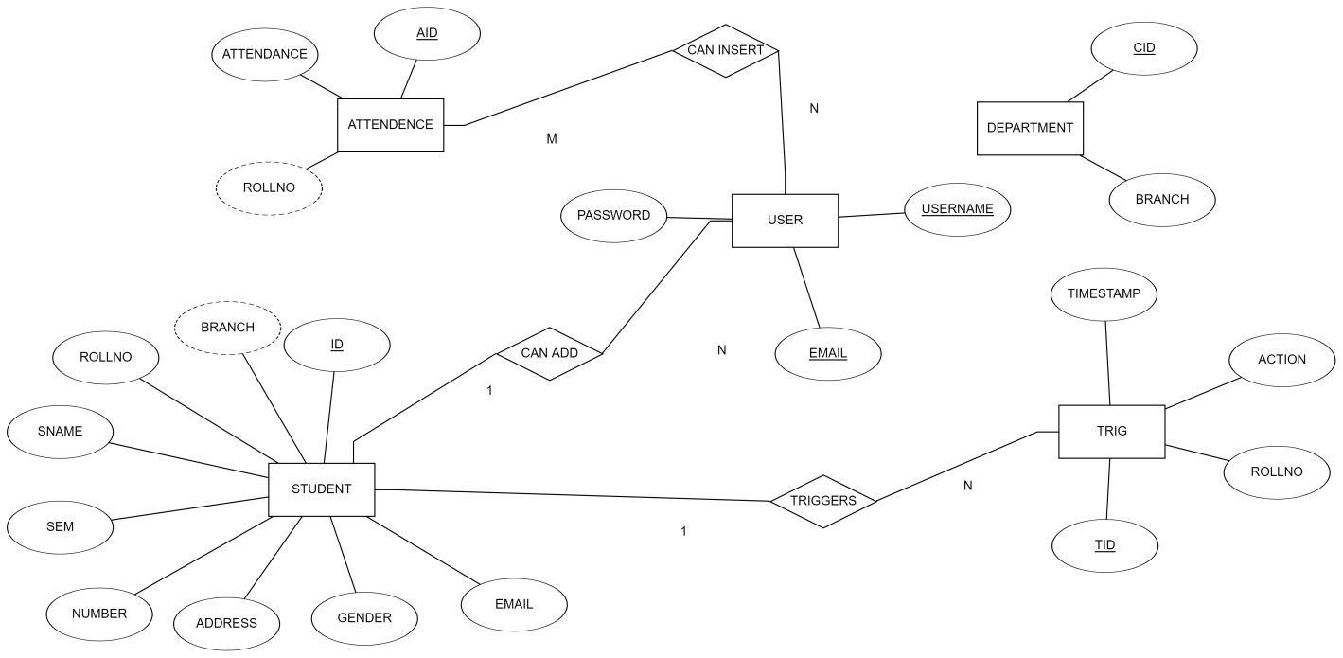
E-R diagram for Student Management System
add
Approved by AICTE |Affiliated to VTU | Recognized by UGC with 2(f) & 12(B) status |Accredited by NBA and NAAC

Slide 4
List of Technologies
Front-end Technologies
HTML
CSS
Bootstrap
Javascript
Back-end Technologies
Python
Database
MYSQL
Approved by AICTE |Affiliated to VTU | Recognized by UGC with 2(f) & 12(B) status |Accredited by NBA and NAAC

Slide 5
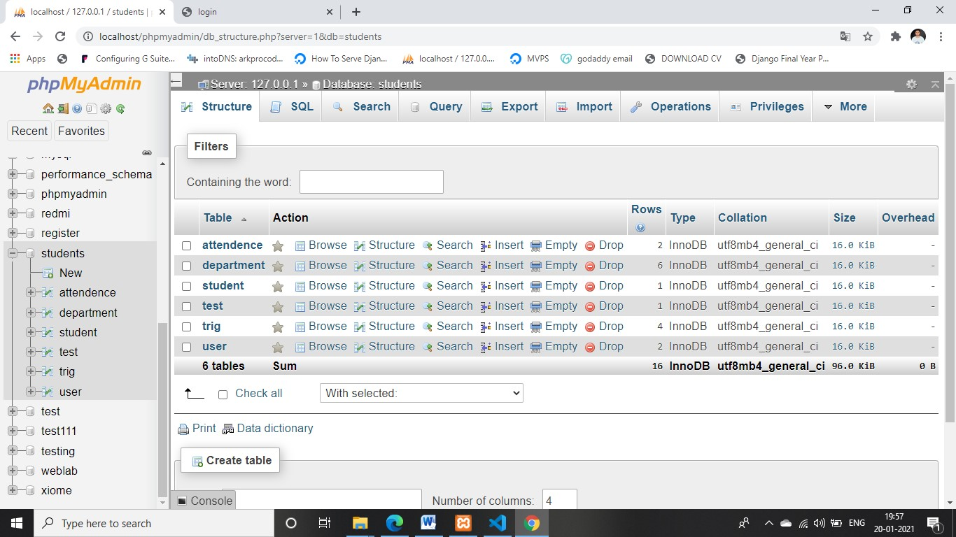
List of Tables
Table 1: DATABASE LOCALHOST
Approved by AICTE |Affiliated to VTU | Recognized by UGC with 2(f) & 12(B) status |Accredited by NBA and NAAC

Slide 6
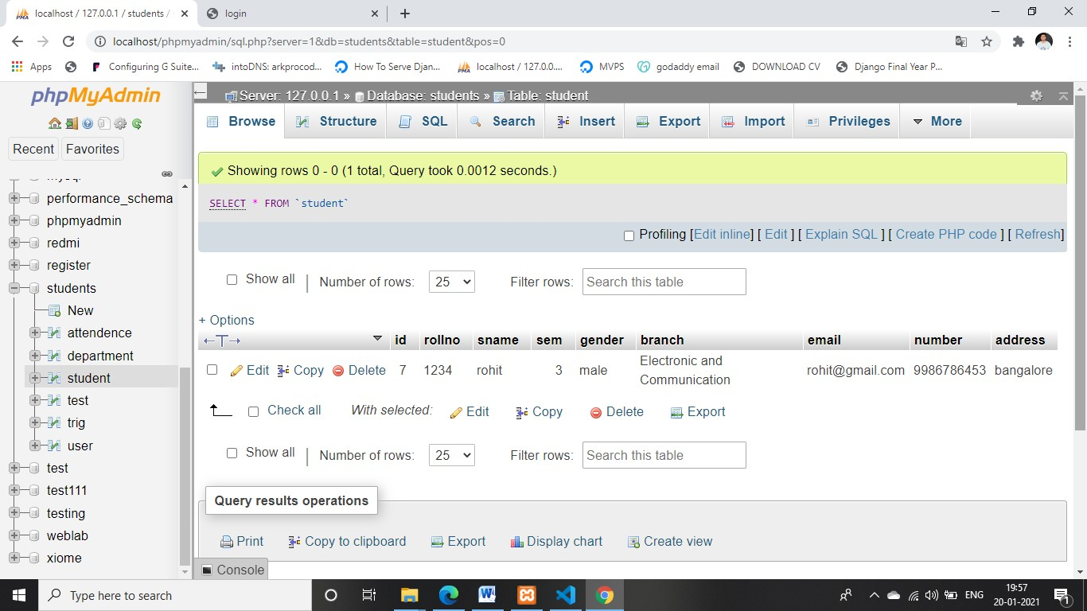
List of Tables (cont.)
Table 2:Student details
Approved by AICTE |Affiliated to VTU | Recognized by UGC with 2(f) & 12(B) status |Accredited by NBA and NAAC

Slide 7
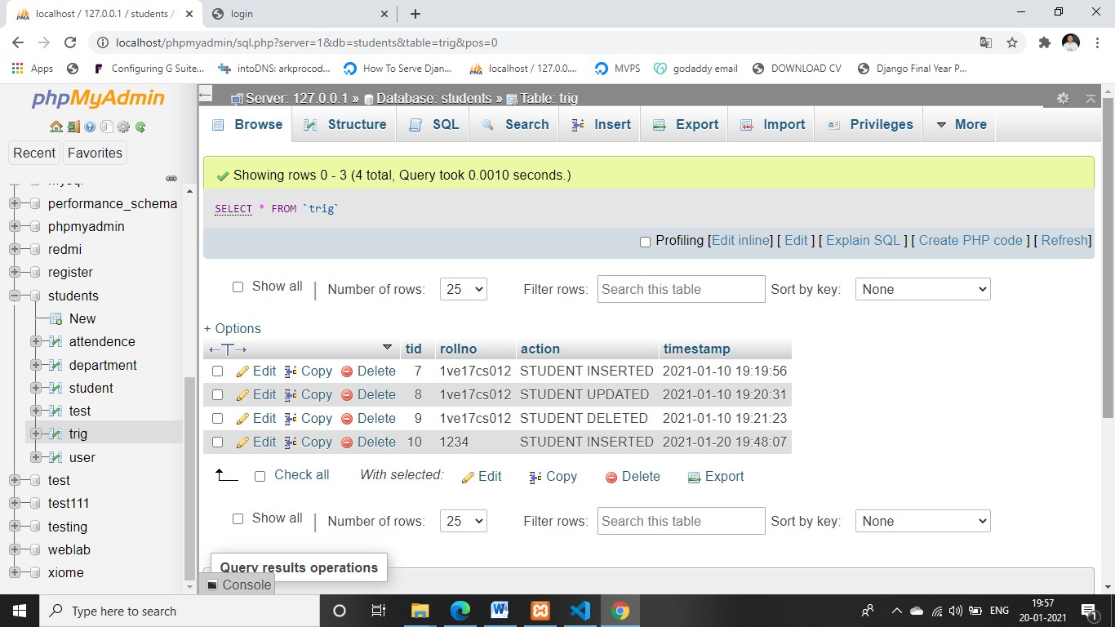
List of Tables (cont.)
Table 3: Trigger Records
Approved by AICTE |Affiliated to VTU | Recognized by UGC with 2(f) & 12(B) status |Accredited by NBA and NAAC

Slide 8
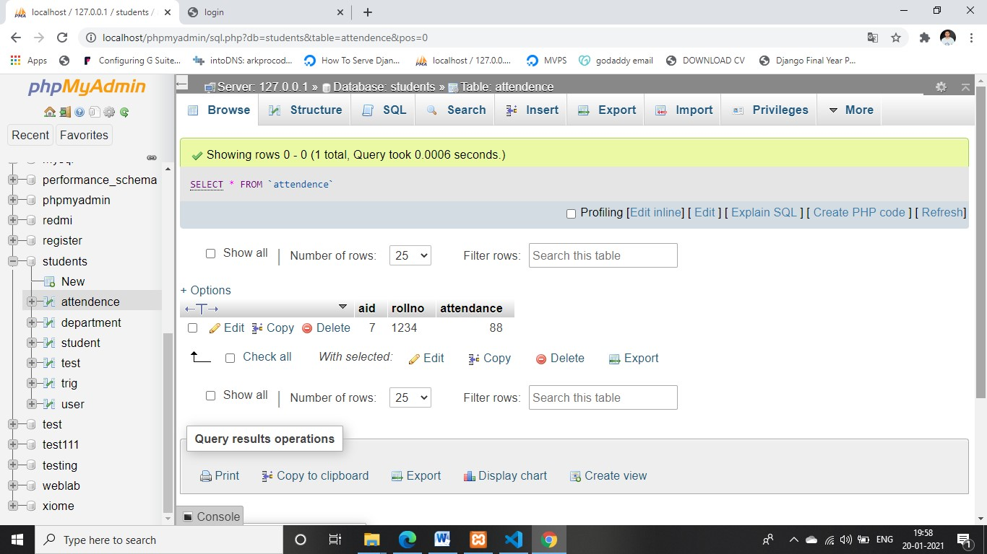
List of Tables (cont.)
Table 4: Attendence
Approved by AICTE |Affiliated to VTU | Recognized by UGC with 2(f) & 12(B) status |Accredited by NBA and NAAC

Slide 9
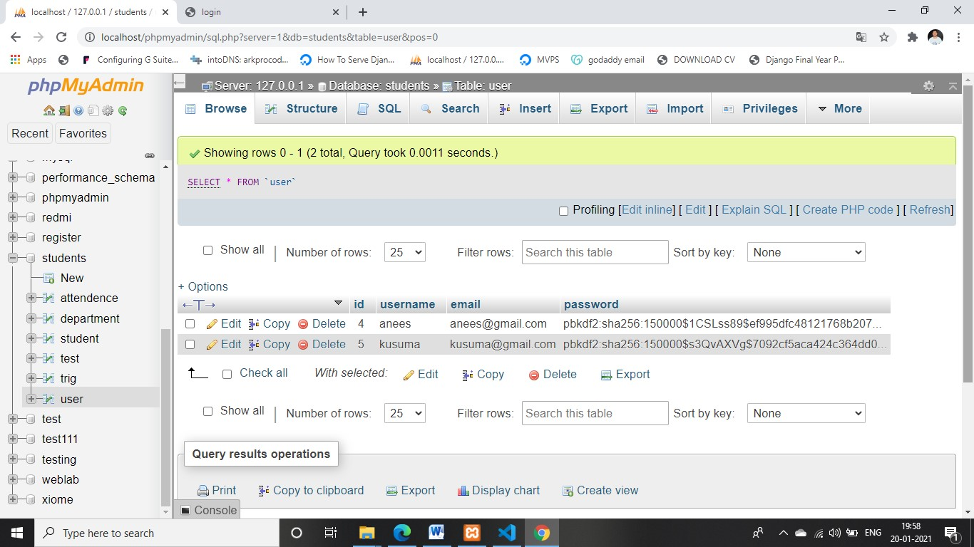
List of Tables (cont.)
Table 5: User Details
Approved by AICTE |Affiliated to VTU | Recognized by UGC with 2(f) & 12(B) status |Accredited by NBA and NAAC

Slide 10

SCREENSHOTS
Figure 1: Home Page
Approved by AICTE |Affiliated to VTU | Recognized by UGC with 2(f) & 12(B) status |Accredited by NBA and NAAC

Slide 11

SCREENSHOTS (cont.)
Figure 2: Sign-up
Approved by AICTE |Affiliated to VTU | Recognized by UGC with 2(f) & 12(B) status |Accredited by NBA and NAAC

Slide 12
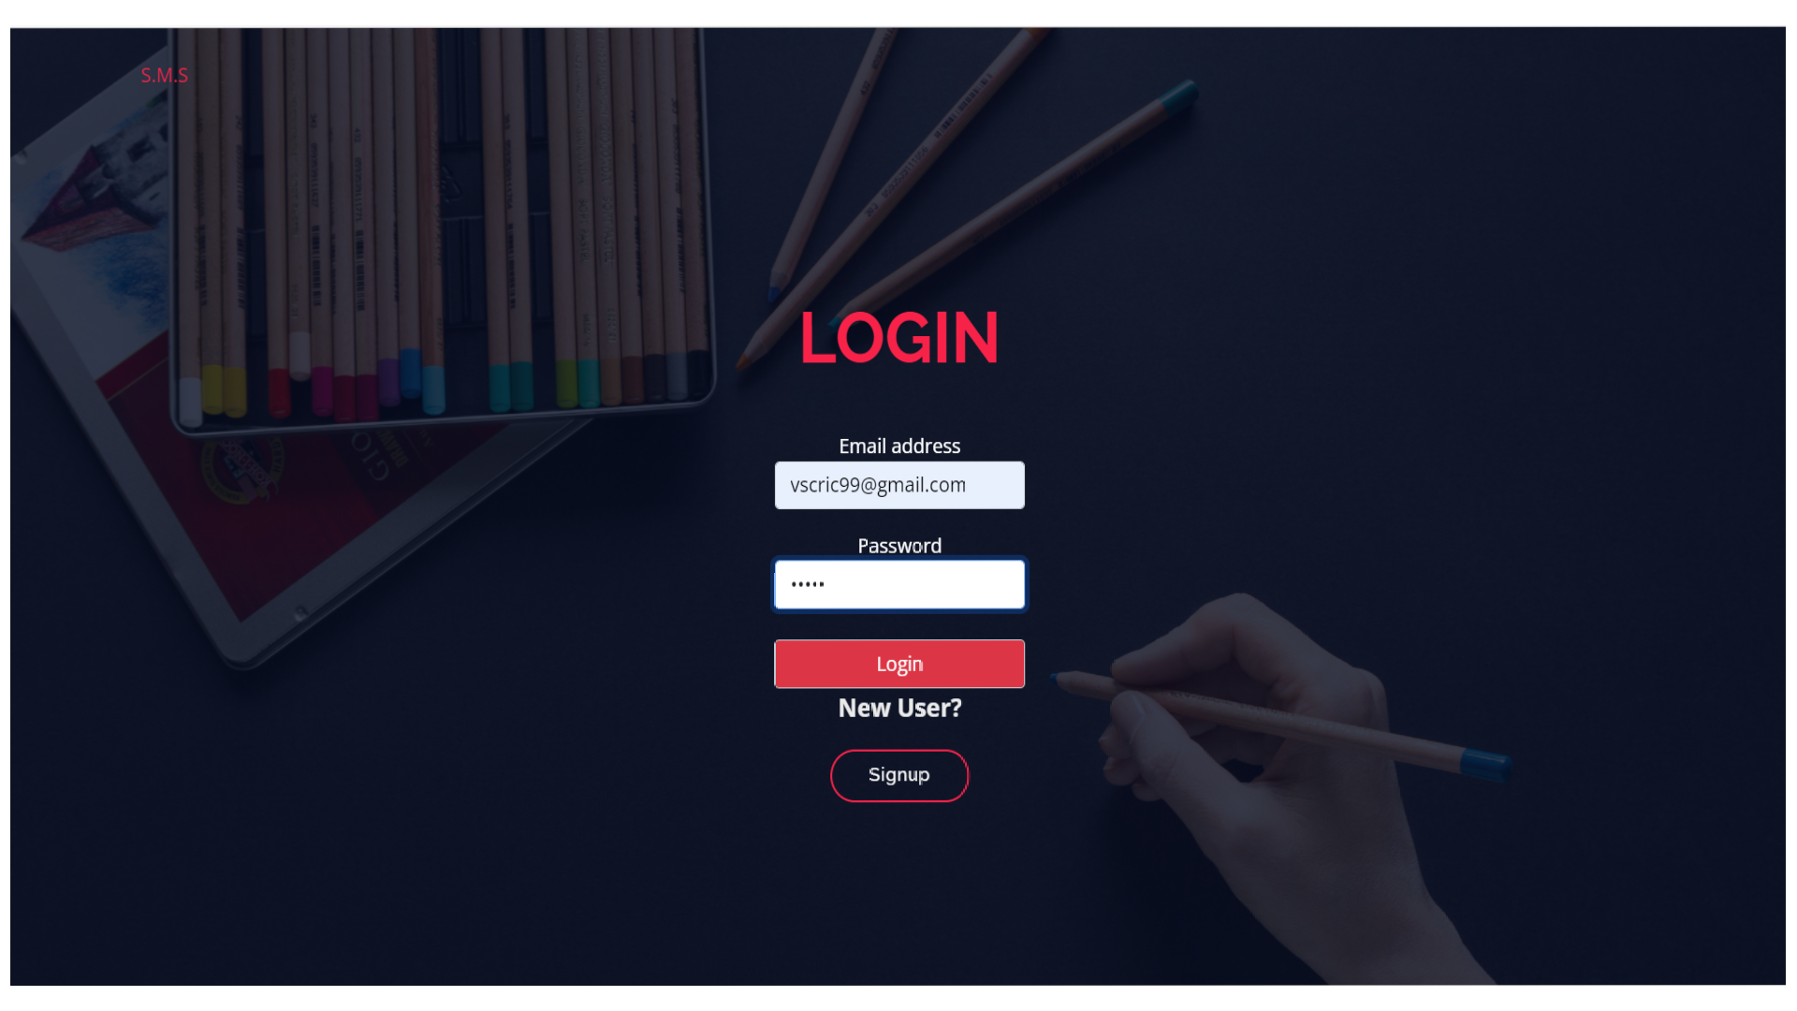
SCREENSHOTS (cont.)
Figure 3: Login page
Approved by AICTE |Affiliated to VTU | Recognized by UGC with 2(f) & 12(B) status |Accredited by NBA and NAAC

Slide 13
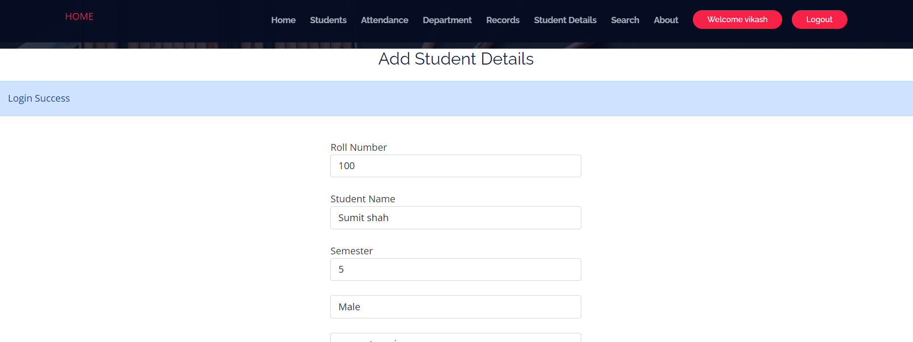
SCREENSHOTS (cont.)
Figure 4: Add Student details
Approved by AICTE |Affiliated to VTU | Recognized by UGC with 2(f) & 12(B) status |Accredited by NBA and NAAC

Slide 14
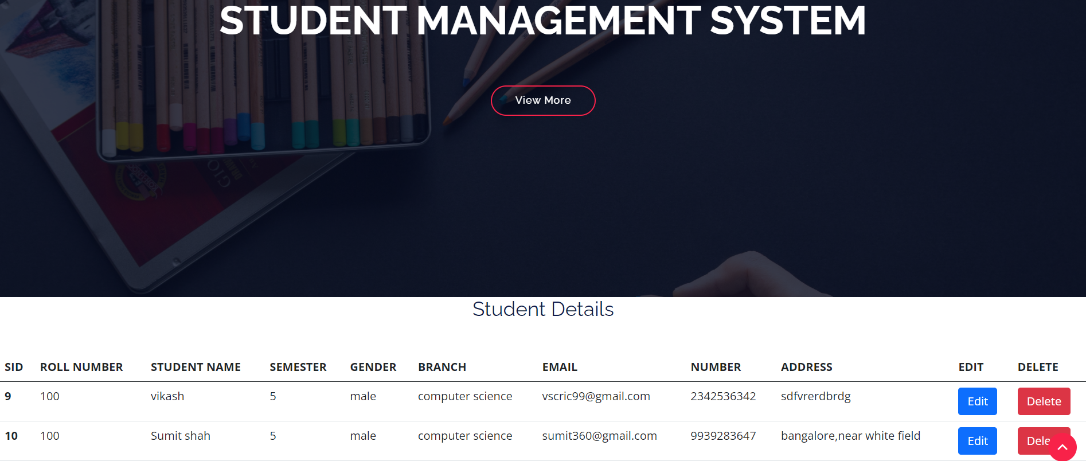
SCREENSHOTS (cont.)
Figure 5: Student Details
Approved by AICTE |Affiliated to VTU | Recognized by UGC with 2(f) & 12(B) status |Accredited by NBA and NAAC

Slide 15
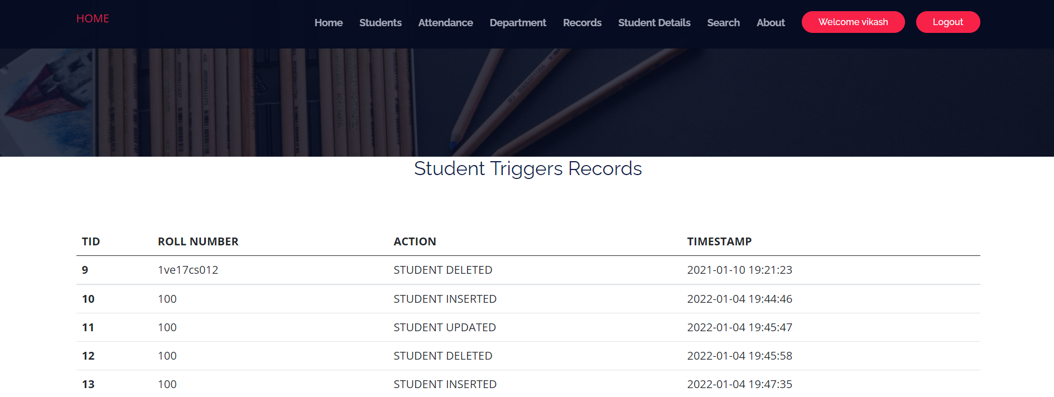
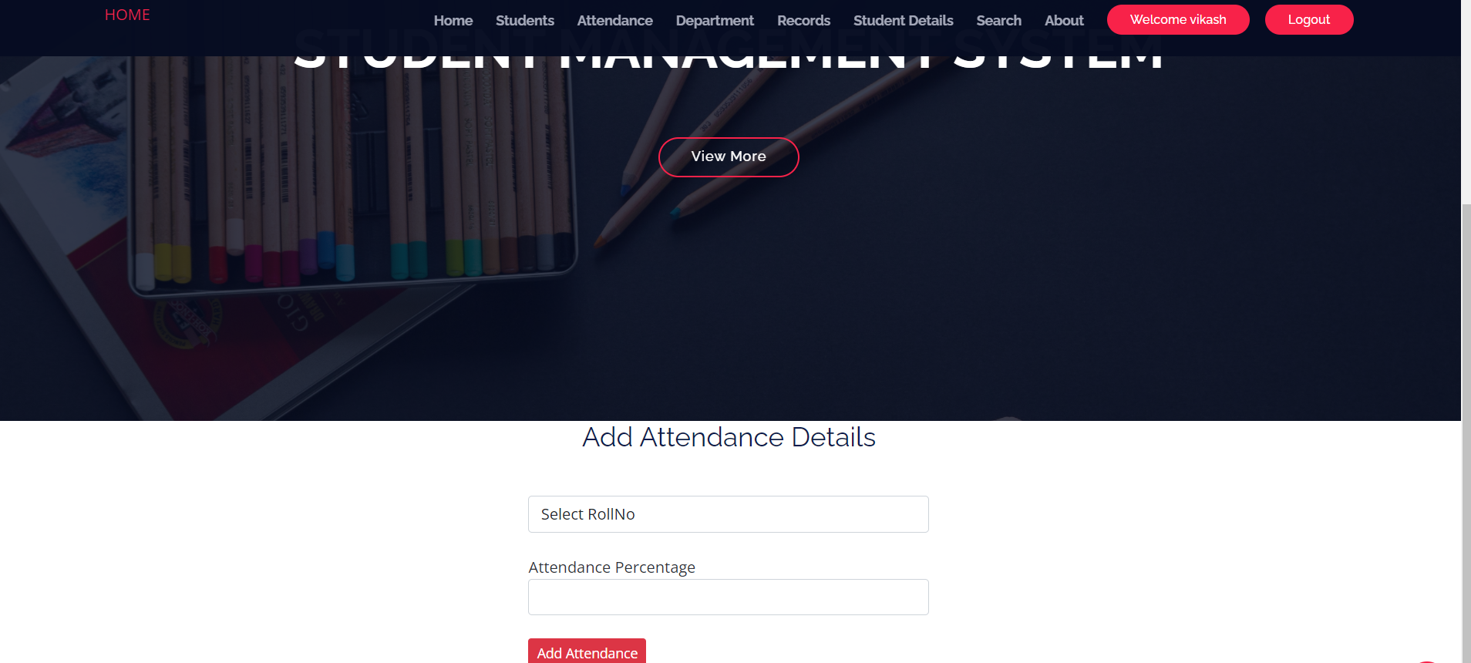
SCREENSHOTS (cont.)
Figure 6: Manage all tables
Approved by AICTE |Affiliated to VTU | Recognized by UGC with 2(f) & 12(B) status |Accredited by NBA and NAAC

Slide 16
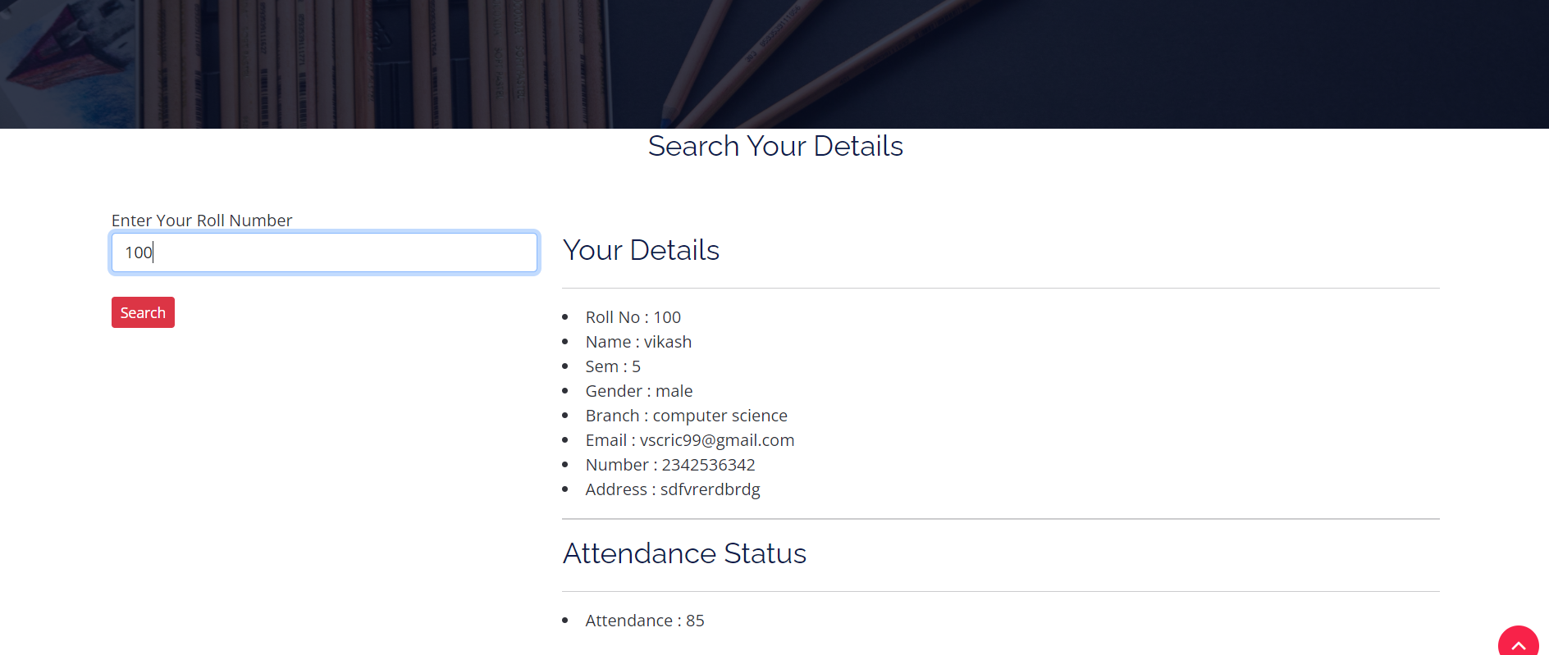
SCREENSHOTS (cont.)
Approved by AICTE |Affiliated to VTU | Recognized by UGC with 2(f) & 12(B) status |Accredited by NBA and NAAC

Slide 17
Thank You!

